Slide 1
PHP - GET & POST Methods

Slide 2
TABLE OF CONTENTS
Introduction
GET and POST methods
Example of POST Method and GET Method Codes
Advantages of using POST and GET methods
Disadvantages of using POST and GET methods
REQUEST VARIABLE
Difference Between PHP GET and POST Methods

Slide 3
INTRODUCTION
There are two ways the browser client can send information to the web server.
1.The GET Method
2.The POST Method
Get and Post methods are the HTTP request methods used inside the <form> tag to send form data to the server.
HTTP protocol enables the communication between the client and the server where a browser can be the client, and an application running on a computer system that hosts your website can be the server.

Slide 4
THE GET Method
The GET method is used to submit the HTML form data. This data is collected by the predefined $_GET variable for processing.
The GET method sends the encoded user information appended to the page request.
The page and the encoded information are separated by the ? Character. http://www.test.com/index.htm?name1=value1&name2=value2
The GET method is restricted to send upto 1024 characters only.
Never use GET method if you have password or other sensitive information to be sent to the server.
GET can't be used to send binary data, like images or word documents, to the server.

Slide 5
EXAMPLE OF GET METHOD
file: test1.html
<html>
<body>
<form action = "gettest.php" method = "GET">
Username: <input type = "text" name = "username" /> <br>
Blood Group: <input type = "text" name = "bloodgroup" /> <br>
<input type = "submit" />
</form>
</body>
</html>

Slide 6
File: gettest.php
<html>
<body>
Welcome <?php echo $_GET["username"]; ?> </br>
Your blood group is: <?php echo $_GET["bloodgroup"]; ?>
</body>
/html>

Slide 7

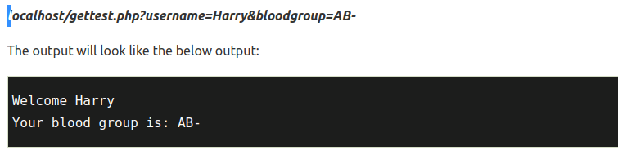

Slide 8
Advantages of GET Method
You can bookmark the page with the specific query string because the data sent by the GET method is displayed in URL.
GET requests can be cached.
GET requests are always remained in the browser history.

Slide 9
Disadvantages of GET Method
The GET method should not be used while sending any sensitive information.
A limited amount of data can be sent using method = "get". This limit should not exceed 2048 characters.
For security reasons, never use the GET method to send highly sensitive information like username and password, because it shows them in the URL.
The GET method cannot be used to send binary data (such as images or word documents) to the server.

Slide 10
THE POST Method
Similar to the GET method, the POST method is also used to submit the HTML form data. But the data submitted by this method is collected by the predefined superglobal variable $_POST instead of $_GET.
The POST method transfers information via HTTP headers. The information is encoded as described in case of GET method and put into a header called QUERY_STRING.
The POST method does not have any restriction on data size to be sent.
The data sent by POST method goes through HTTP header so security depends on HTTP protocol. By using Secure HTTP you can make sure that your information is secure.
The POST method can be used to send ASCII as well as binary data.

Slide 11
Example of POST Method
file: test2.html
<html>
<body>
<form action = "posttest.php" method = "post">
Username: <input type = "text" name = "username" /> <br>
Blood Group: <input type = "text" name = "bloodgroup" /> <br>
<input type = "submit" />
</form>
</body>
</html>

Slide 12
file: posttest.php
<html>
<body>
Welcome <?php echo $_POST["username"]; ?> </br>
Your blood group is: <?php echo $_POST["bloodgroup"]; ?>
</body>
</html>

Slide 13

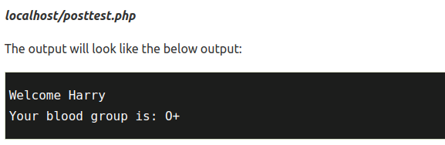

Slide 14
Advantages of POST Method
The POST method is useful for sending any sensitive information because the information sent using the POST method is not visible to anyone.
There is no limitation on size of data to be sent using the POST Method. You can send a large amount of information using this method.
Binary and ASCII data can also be sent using the POST method.
Data security depends on the HTTP protocol because the information sent using the POST method goes through the HTTP header. By using secure HTTP, you can ensure that your data is safe.

Slide 15
Disadvantages of POST Method
POST requests never remain in the browser history.
Since it does not embed data submitted by the POST Method in the URL, hence it is not possible to bookmark the page.
POST requests are not cached.

Slide 16
$_REQUEST variable
The $_REQUEST variable is a superglobal variable, which can hold the content of both $_GET and $_POST variable.
In other words, the PHP $_REQUEST variable is used to collect the form data sent by either GET or POST methods.
It can also collect the data for $_COOKIE variable because it is not a method-specific variable.

Slide 17
<?php
if( $_REQUEST["name"] || $_REQUEST["age"] ) {
echo "Welcome ". $_REQUEST['name']. "<br />";
echo "You are ". $_REQUEST['age']. " years old.";
exit();
}
?>
<html>
<body>
<form action = "<?php $_PHP_SELF ?>" method = "POST">
Name: <input type = "text" name = "name" />
Age: <input type = "text" name = "age" />
<input type = "submit" />
</form>
</body>
</html>

Slide 18
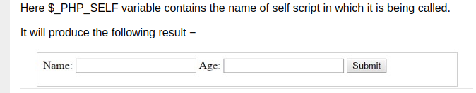

Slide 19
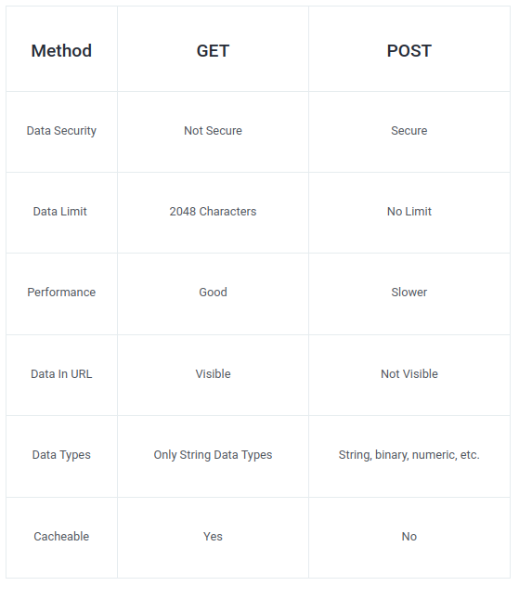
Difference Between PHP GET and POST Method

Slide 20
THANK YOU

